Slide 1

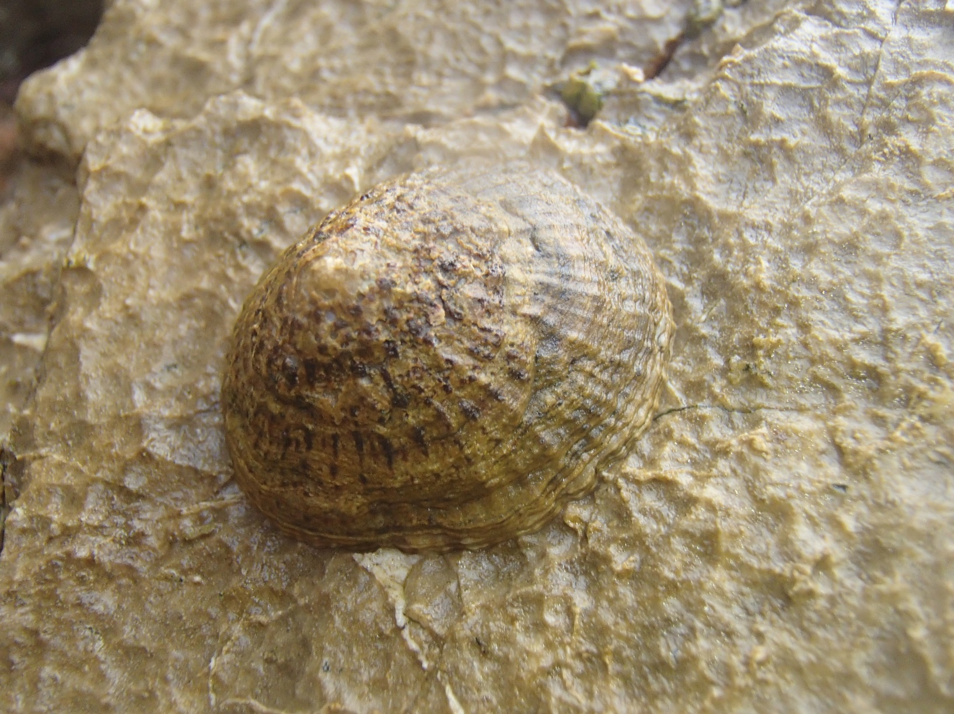



Quantification of the foraging activity of Patella caerulea and P. rustica under simulated tides using photographic analysis of radula scratches
Juan Sempere, Francisco Sedano, César Megina, José Carlos García, Free Espinosa
Departamento de Zoología
Universidad de Sevilla

Slide 2
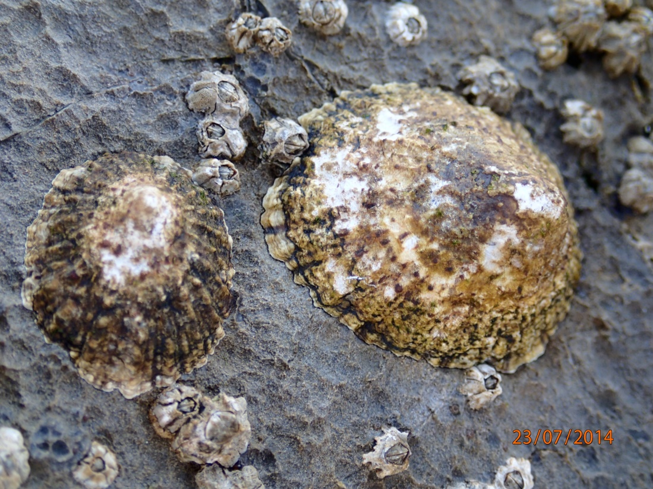
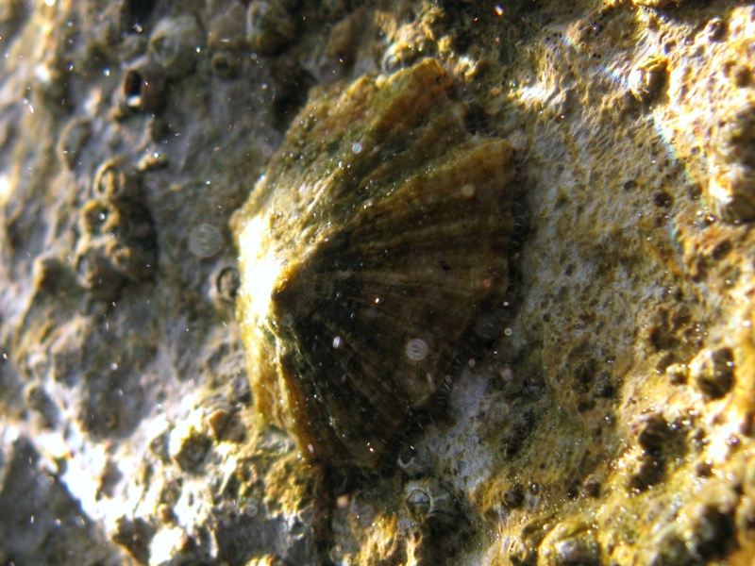
Patella rustica
- Supralittoral zone
Cyanobacteria dominant in stomach
Wave intensity mainly modulate activity
Long and irregular trips, frequently changing home-scar
Patella caerulea
- Upper midlittoral zone
Medium content of cyanobacteria in stomach
Tidal and dial cycles modulate activity
Short and regular trips, stable home-scar

Slide 3
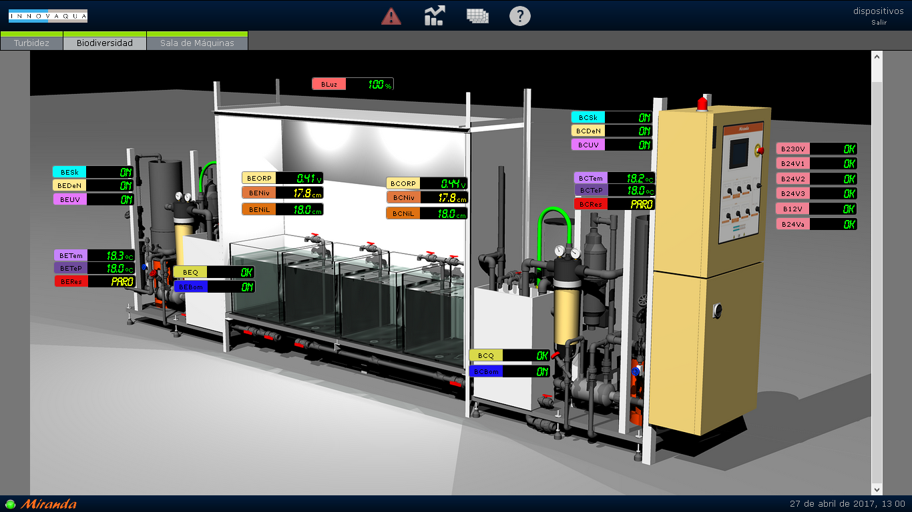
Tidal simulation tanks module

Slide 4
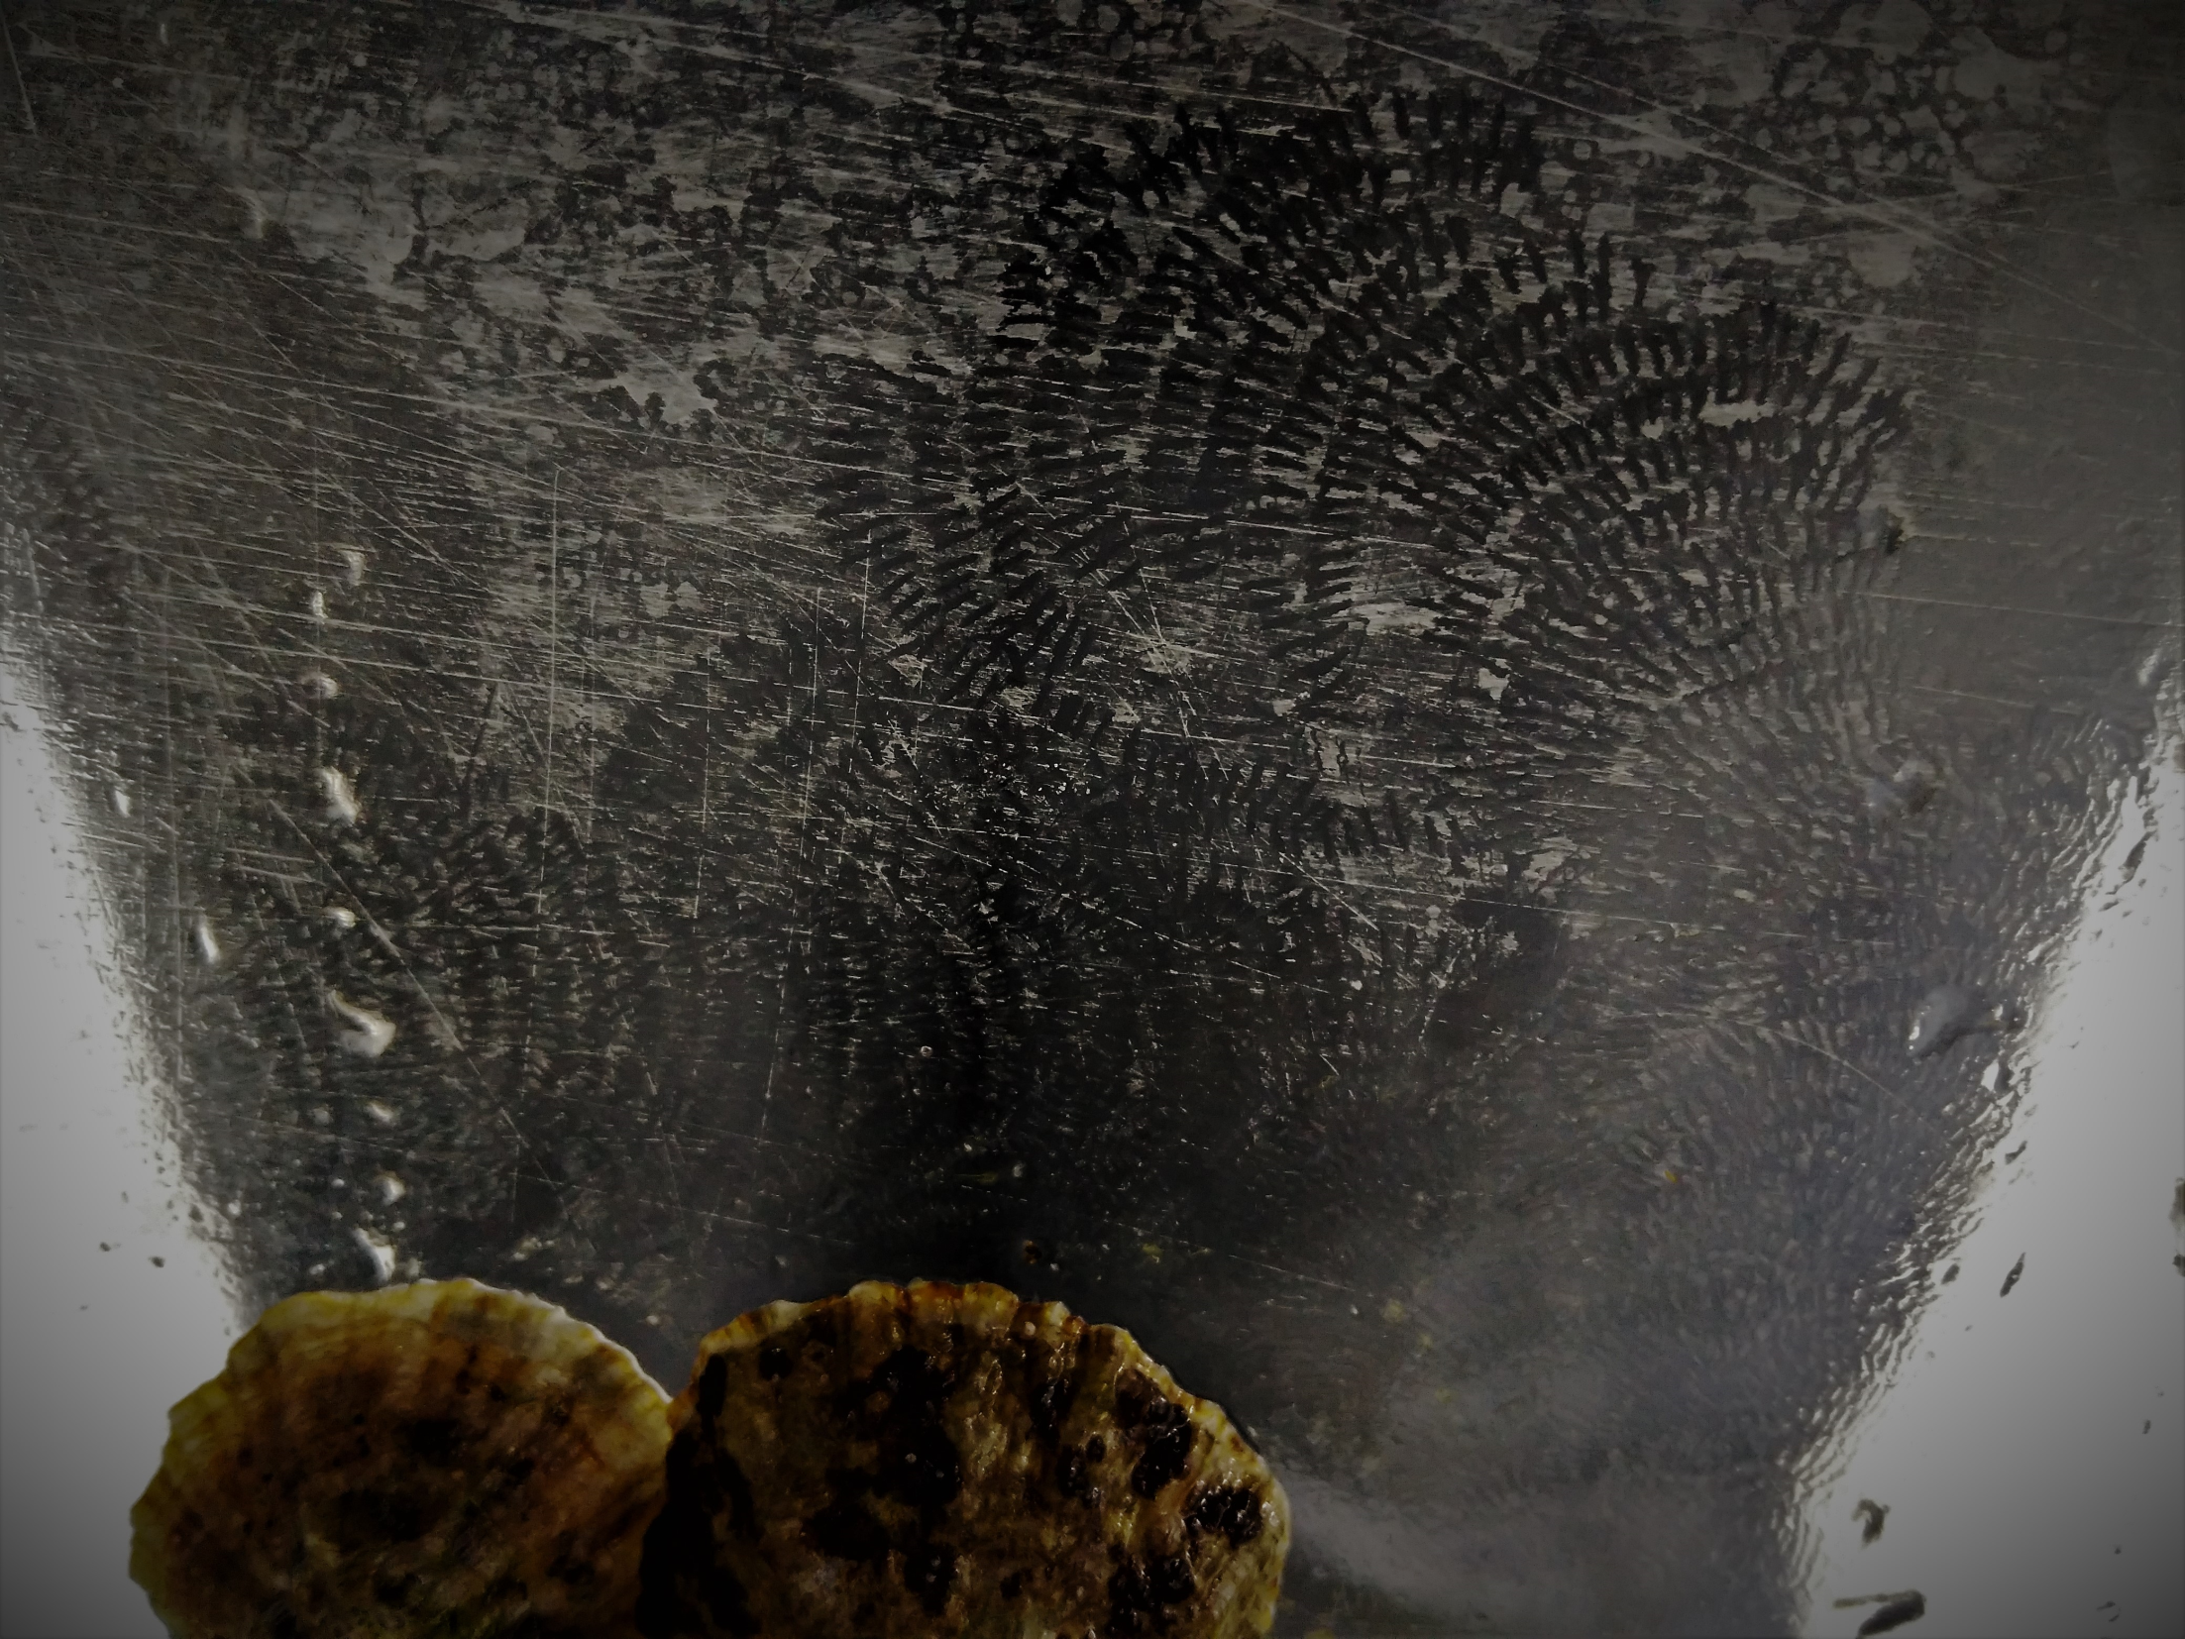

Slide 5
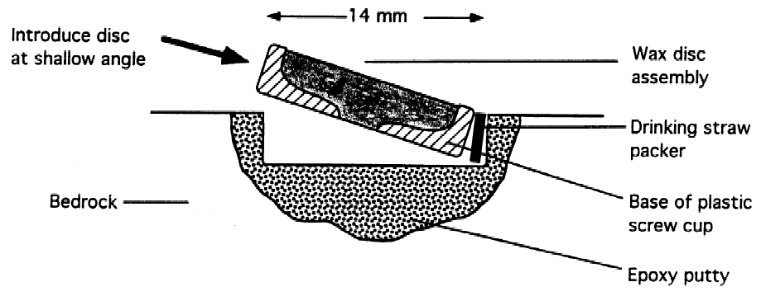
Objetivos:
Test Thompson et al. methodology for the recording of foraging marks for Patella genus.
Get feeding activity measurements on aquariums for P. rustica and P. caerulea under different tidal regimes.

Slide 6
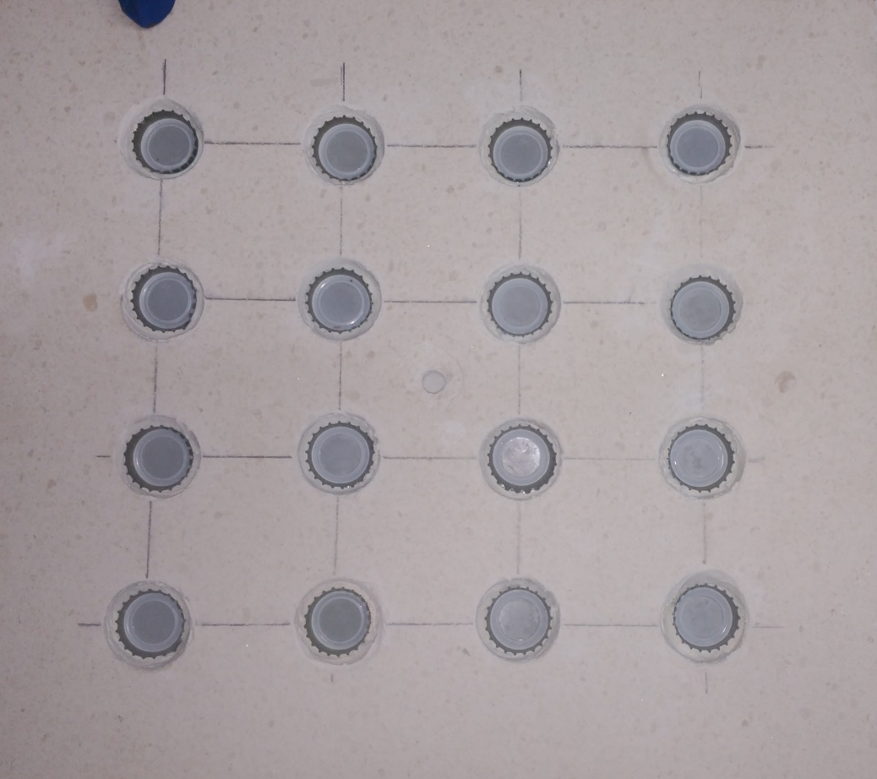
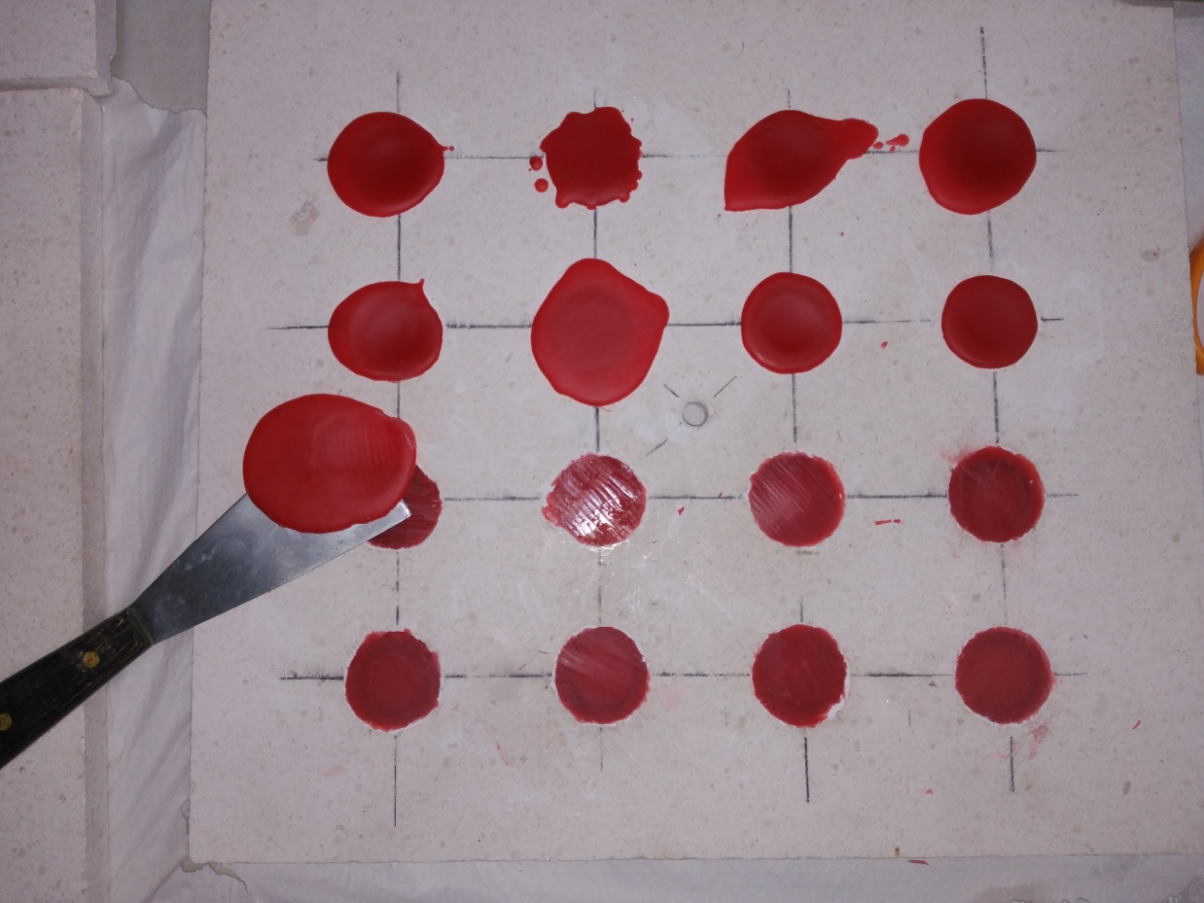
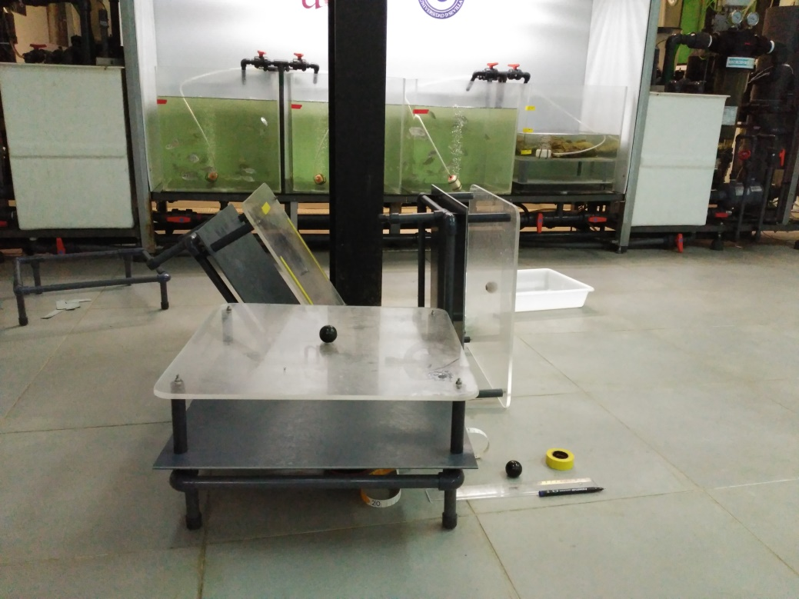
Spring tides: 24cm
Neap tides: 8cm

Slide 7
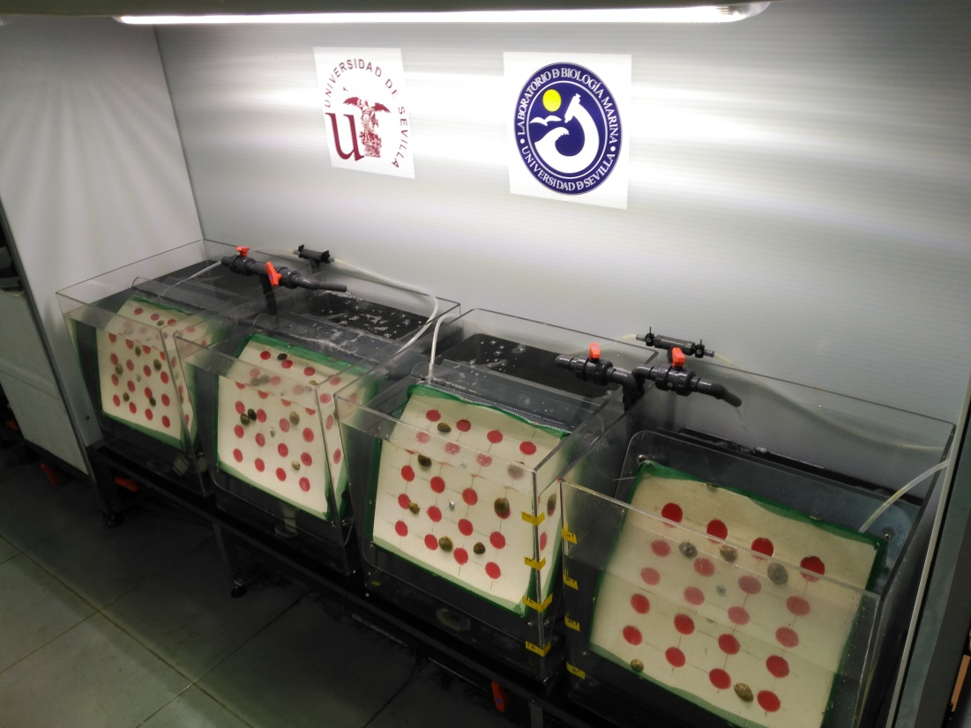

Slide 8
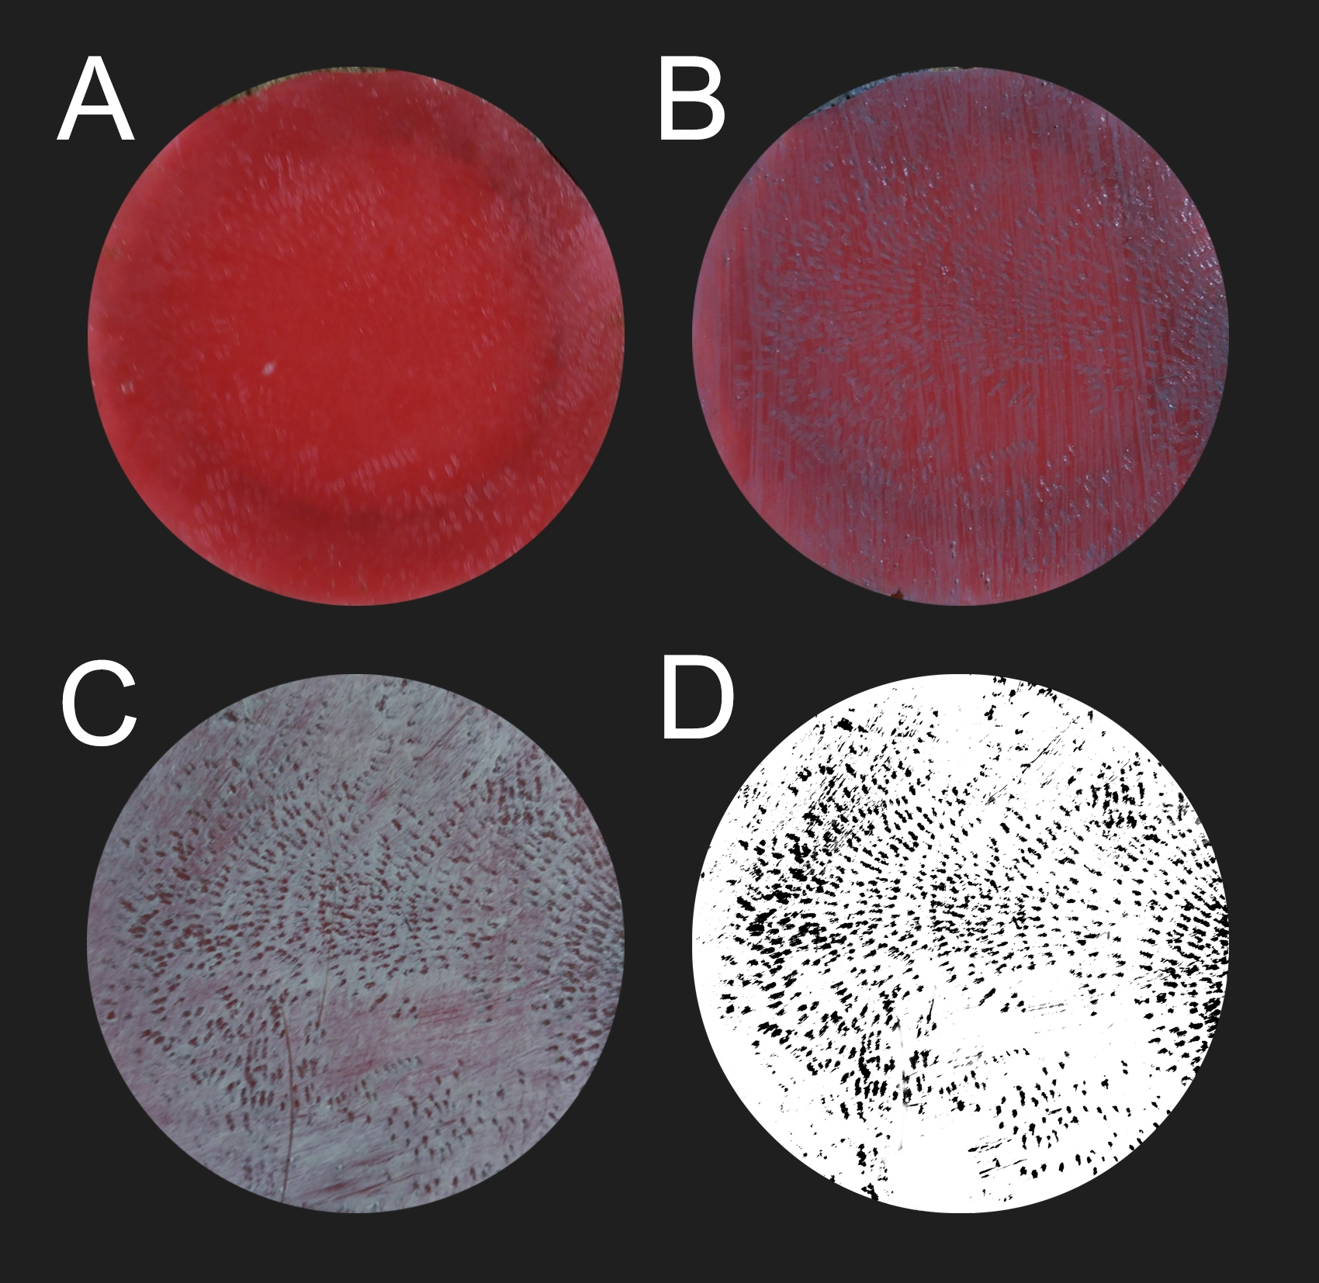

Slide 9
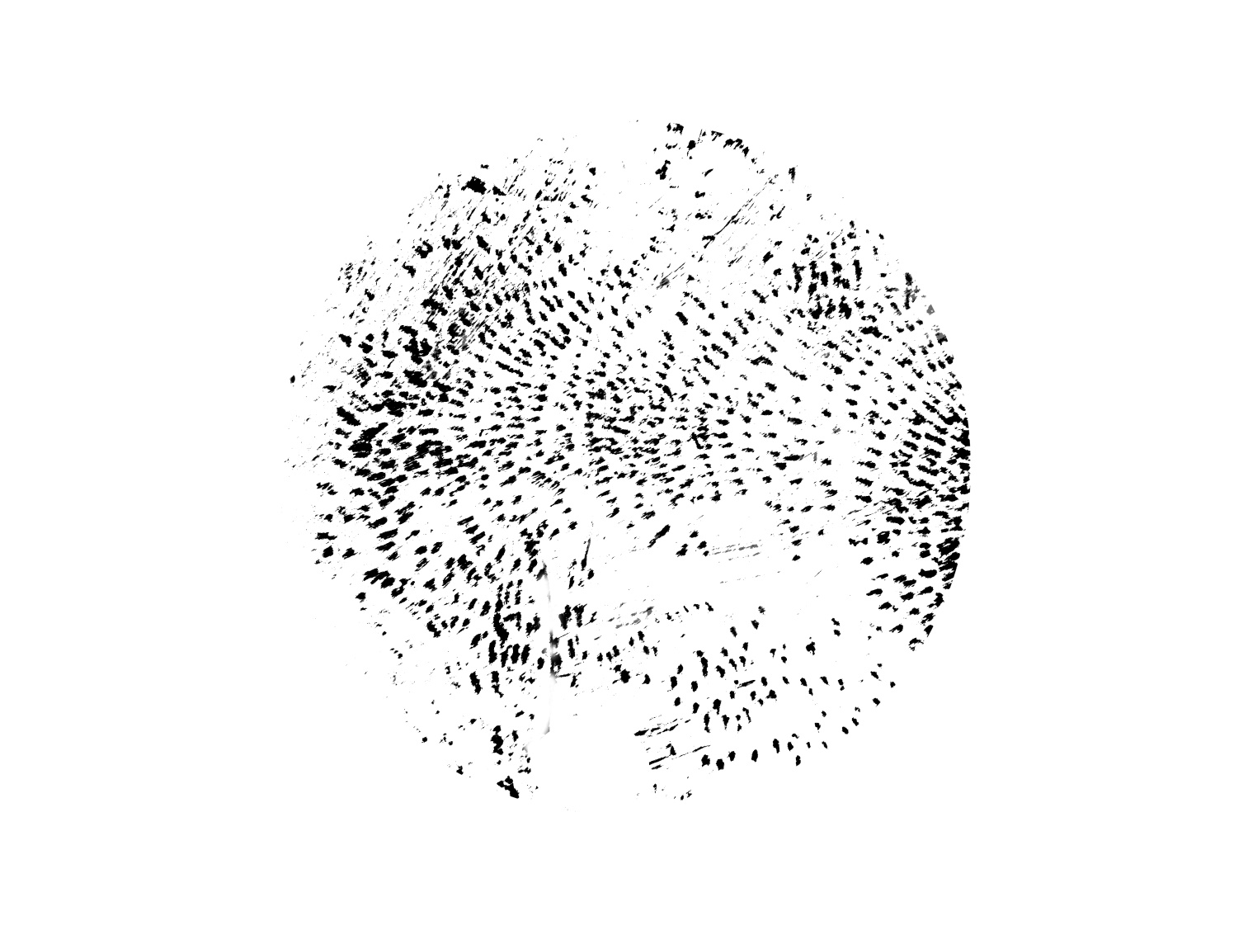
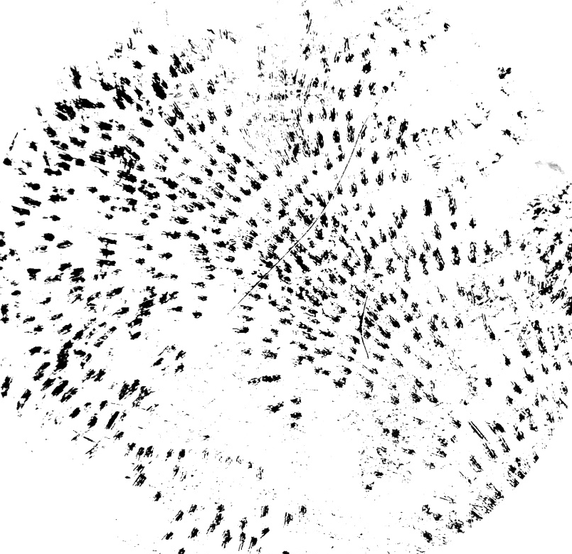
Foraging patterns and activity
for Patella caerulea and P. rustica
Linnaeus 1758 (Mollusca, Gastropoda)

Slide 10
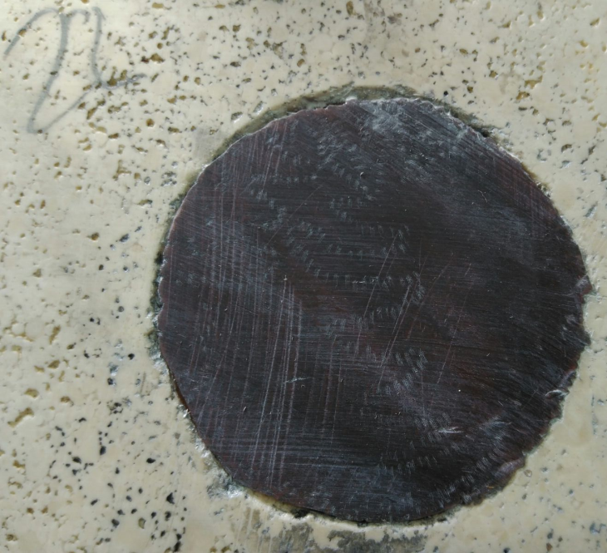
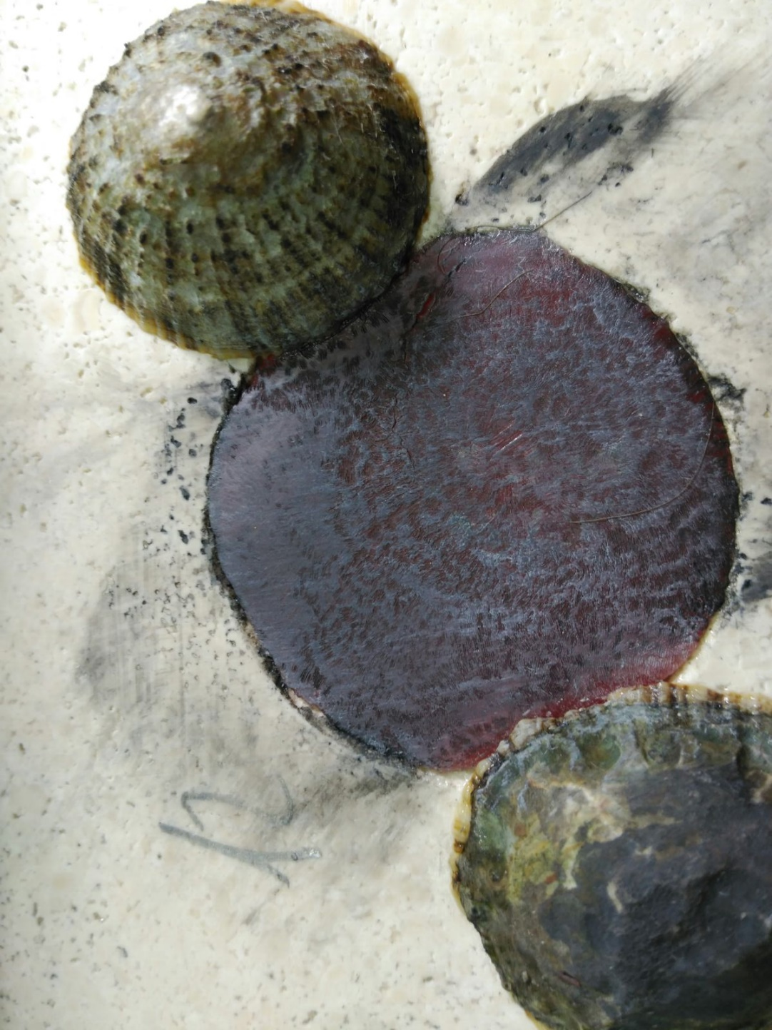
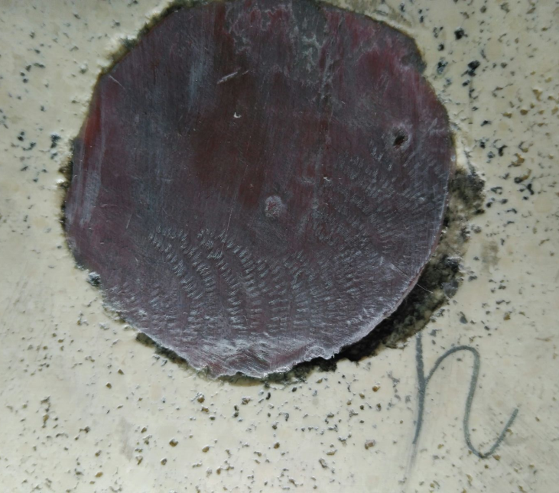

Slide 11
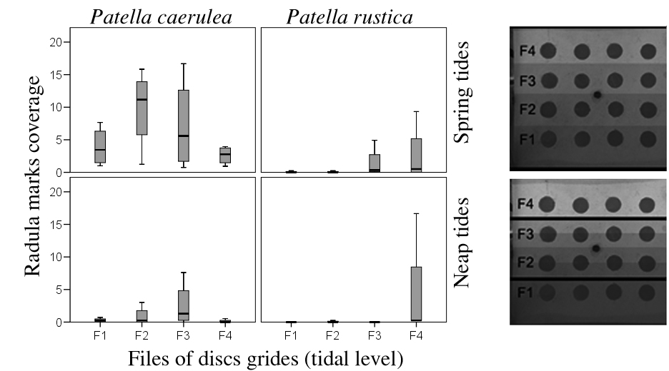
Foraging activity under simulated tidal regimes

Slide 12




